Slide 1
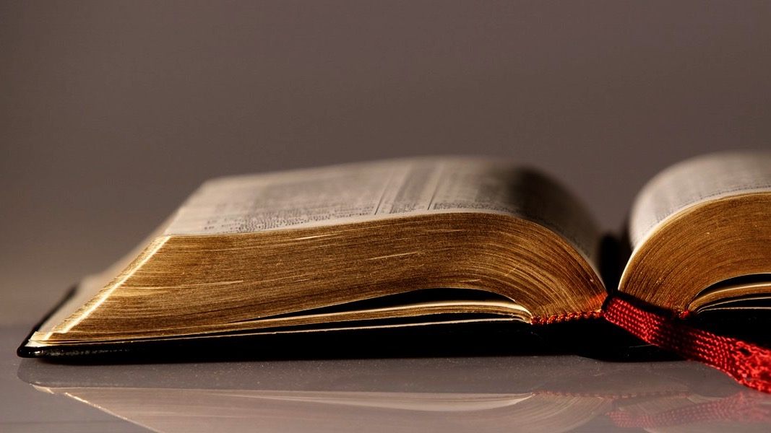
Welcome to
Our Sunday School
We’ll start at 9:07
visit OurSundaySchool.com for more about our class

Slide 2
Ephesians, week 1: an introduction

Slide 3
Ephesians, week 1: an introduction
Our resources
The city of Ephesus
Ephesus in the Bible
The letter to the Ephesians
Our series

Slide 4
Ephesians, week 1: an introduction
Our resources
The city of Ephesus
Ephesus in the Bible
The letter to the Ephesians
Our series

Slide 5
The resources
The Holy Spirit
Ephesians (Legacy Standard Bible)
Our handout
OurSundaySchool.com

Slide 6
Visitors: loan you a copy for today
Members: get a print edition
Online: visit OurSundaySchool.com

Slide 7
What’s new in this handout
Christian Standard Bible (CSB) → Legacy Standard Bible (LSB)
Added reflection/journal and quotes from commentary pages (p. 83)
[Variants]

Slide 8
Page 6: About This Resource

Slide 9
Page 7: About This Resource

Slide 10
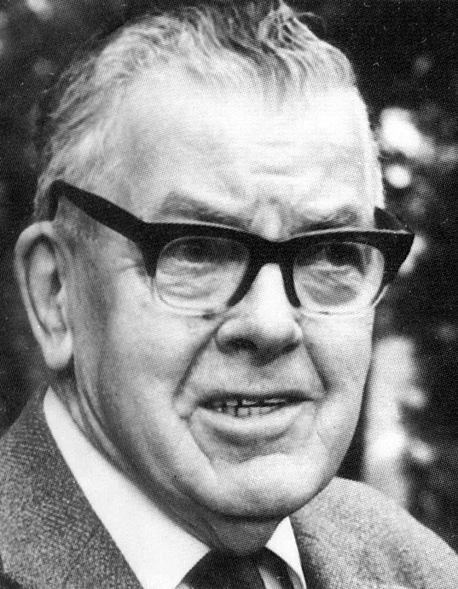
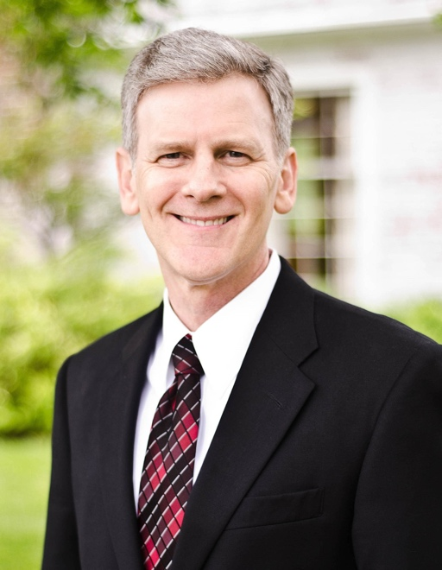
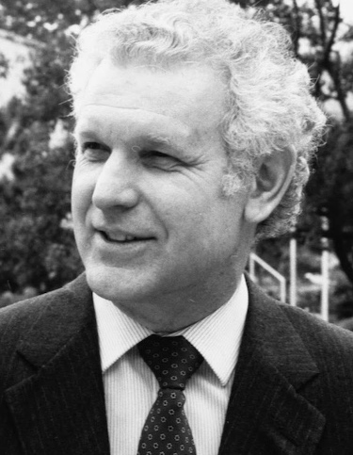
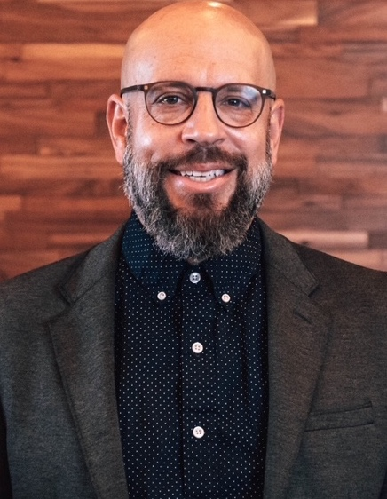
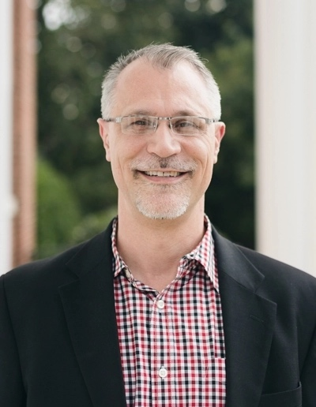
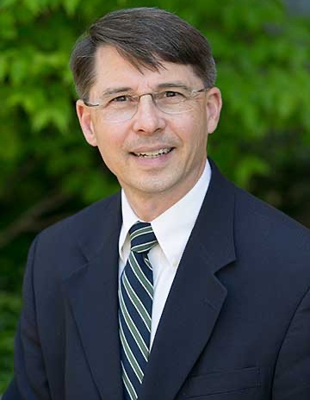
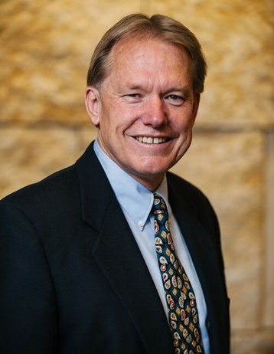
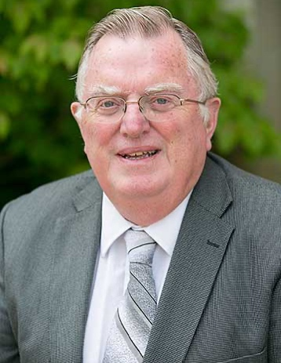
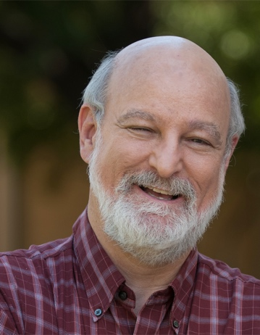
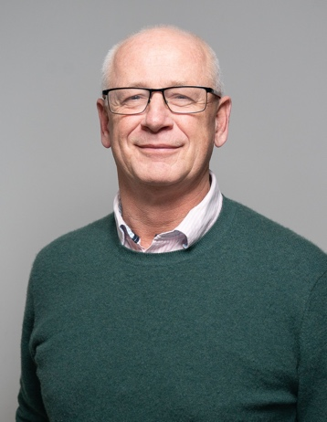
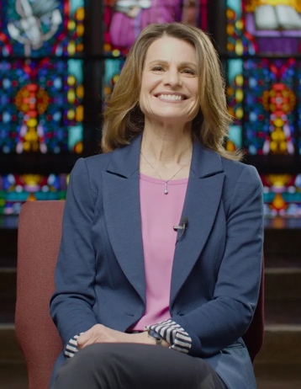
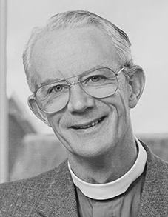
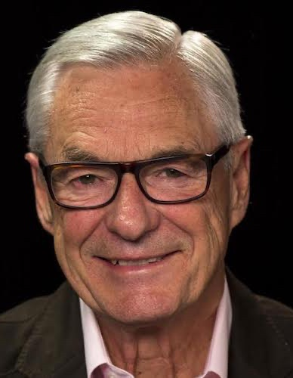
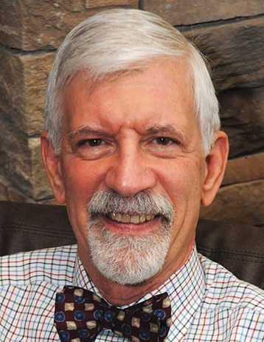
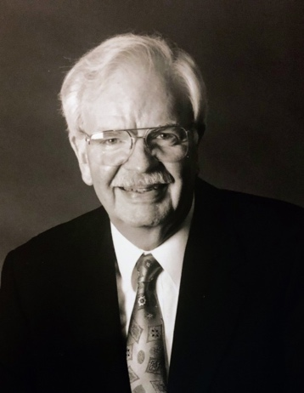
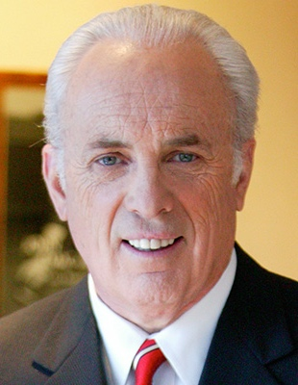
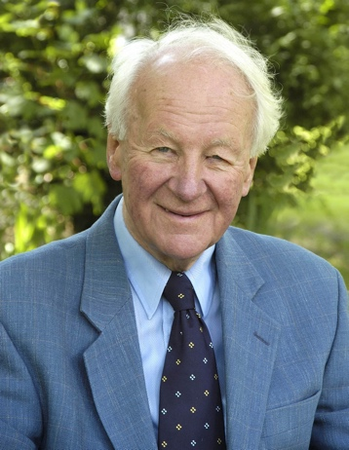
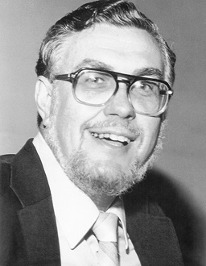
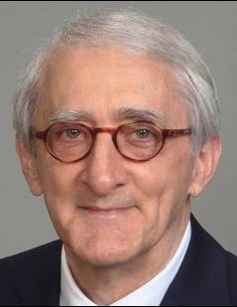
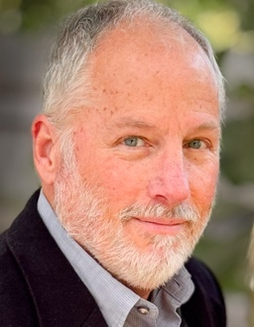
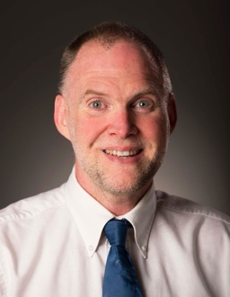
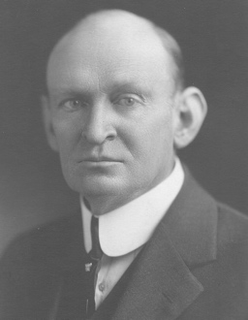
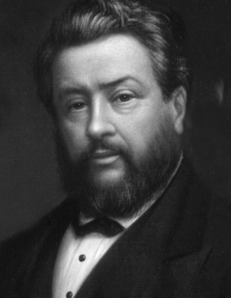
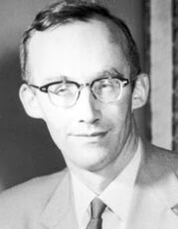
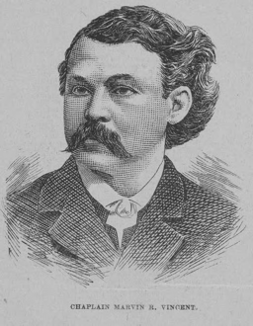
Page 8: Commentaries

Slide 11
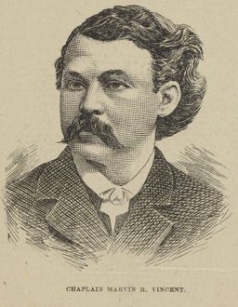
Page 8: Commentaries

Slide 12
Page 8: Commentaries

Slide 13
Page 8: Commentaries

Slide 14
Page 8: Commentaries
Quotes are due to Jim by Thursday night
If you would like one, let Jim know

Slide 15
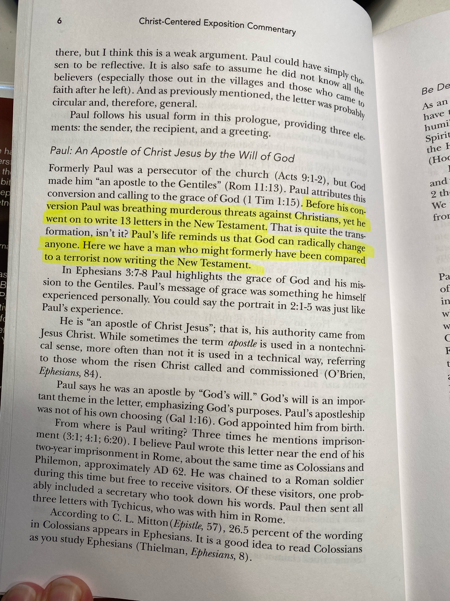
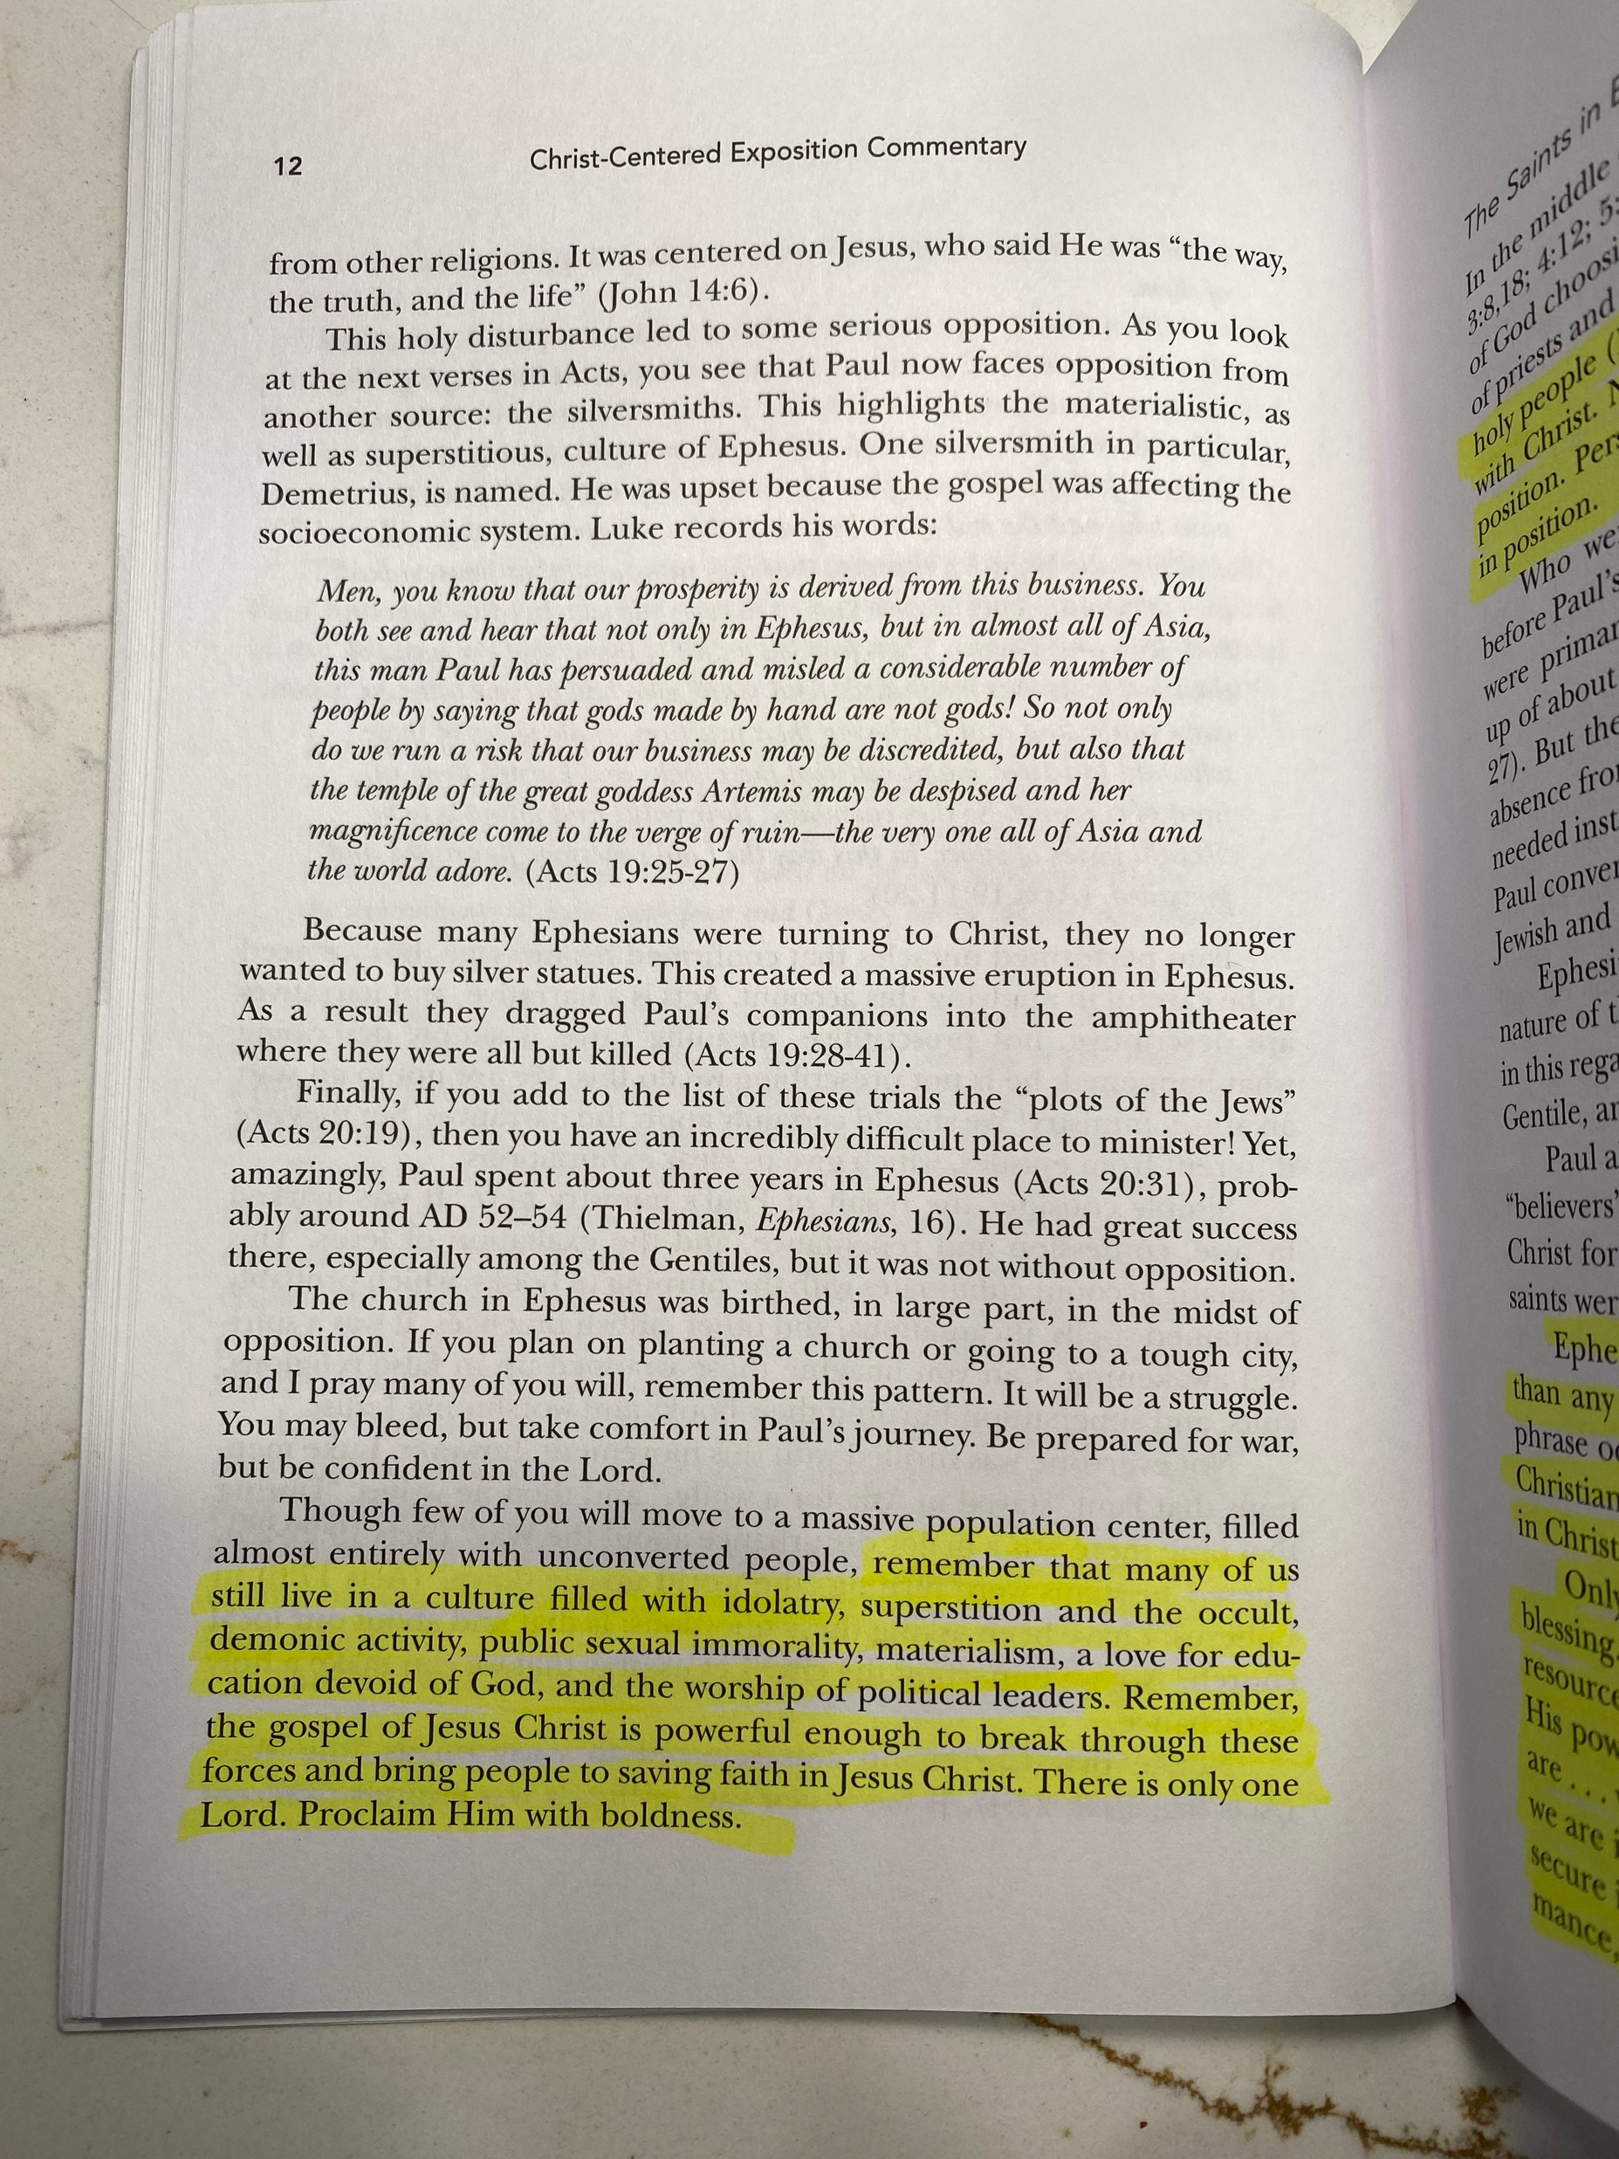
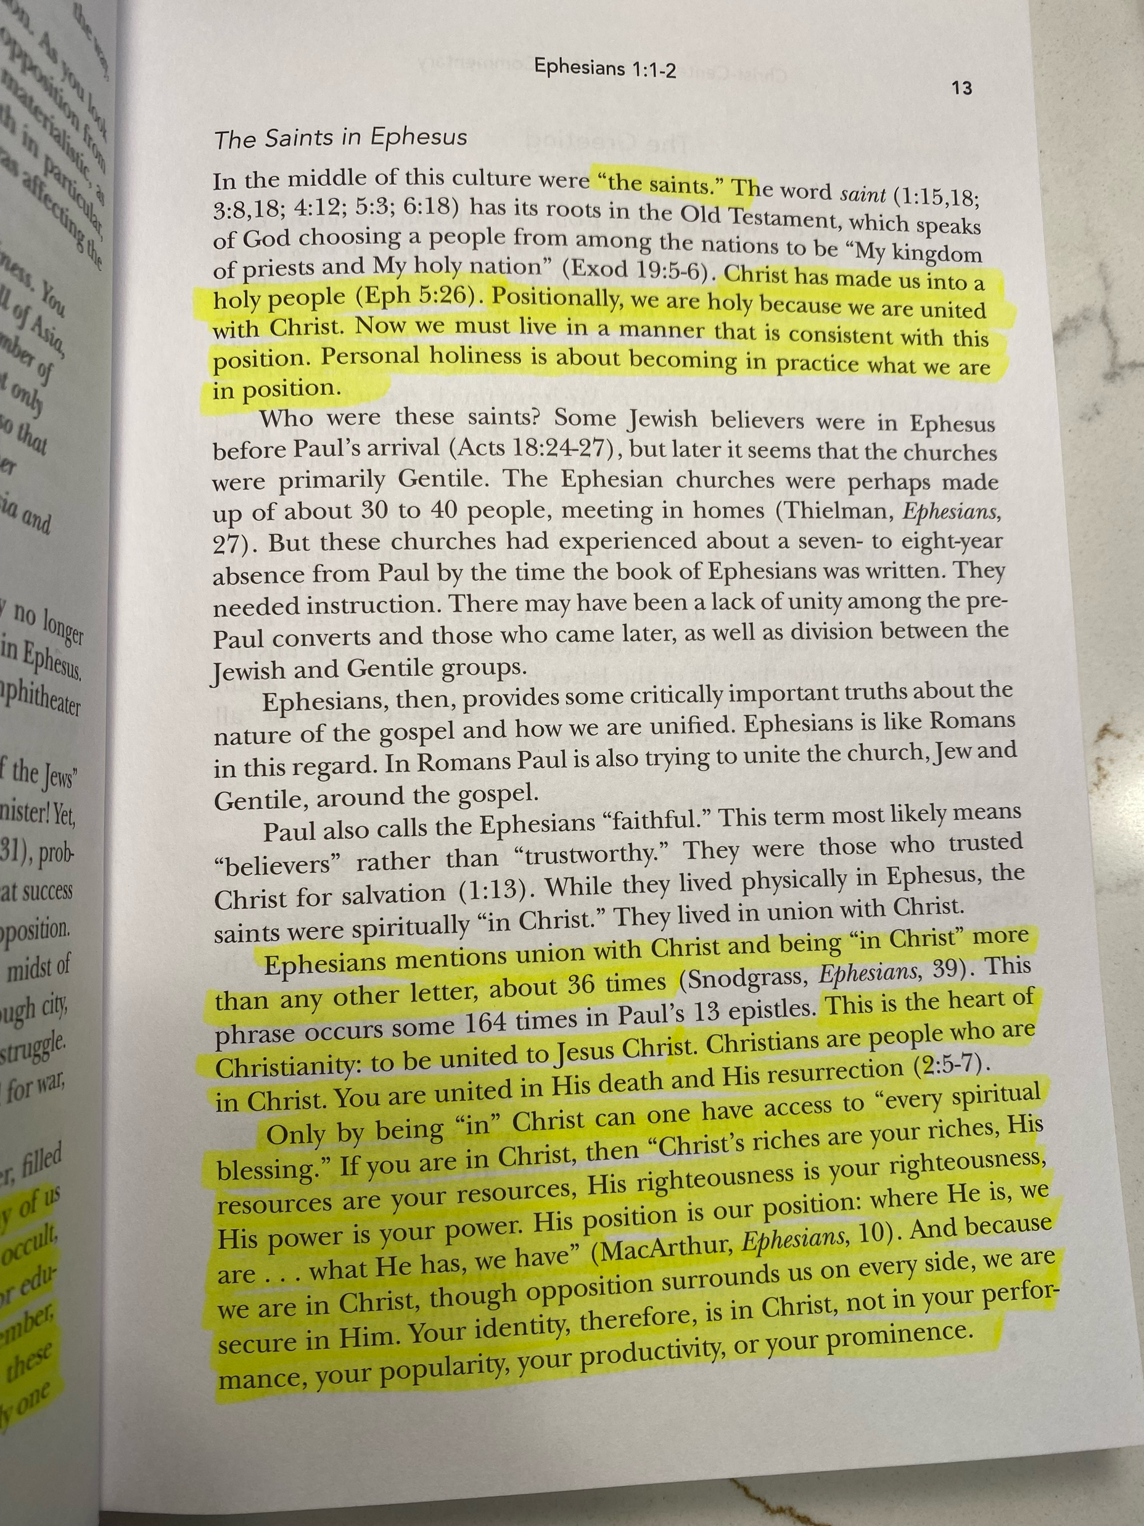
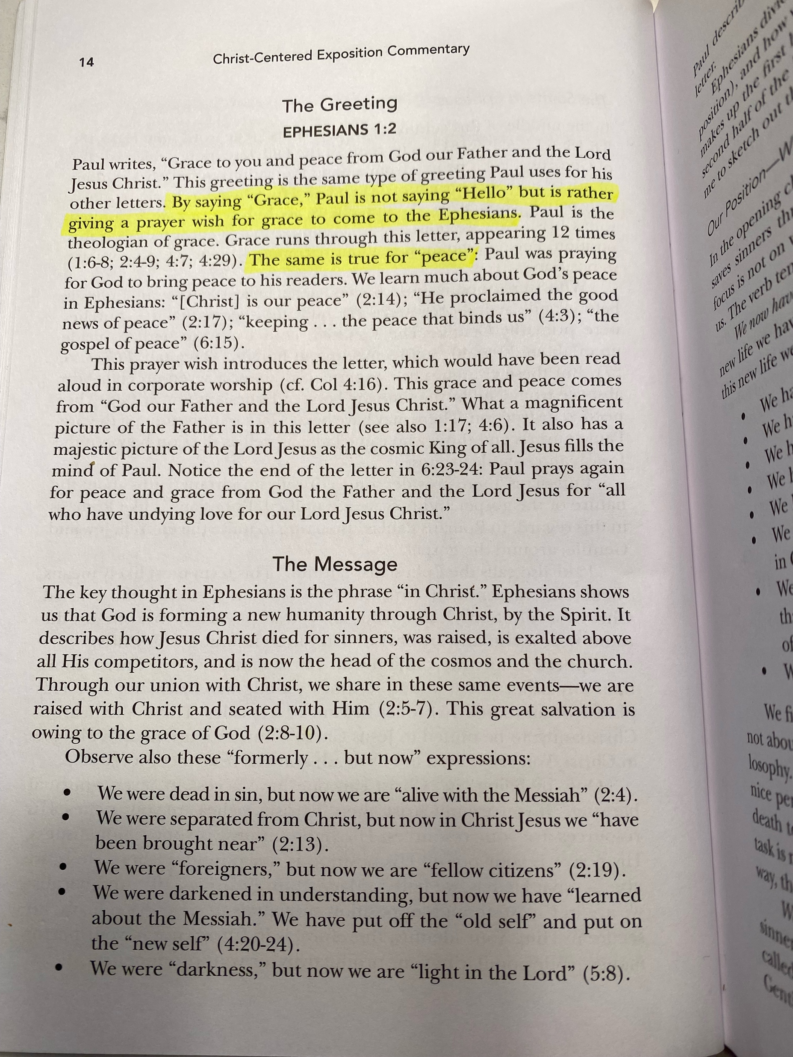

Slide 16
Page 8: Commentaries
Quotes are due to Jim by Thursday night
If you would like one, let Jim know

Slide 17
Pages 9–13: Cheat Sheets for Greek

Slide 18
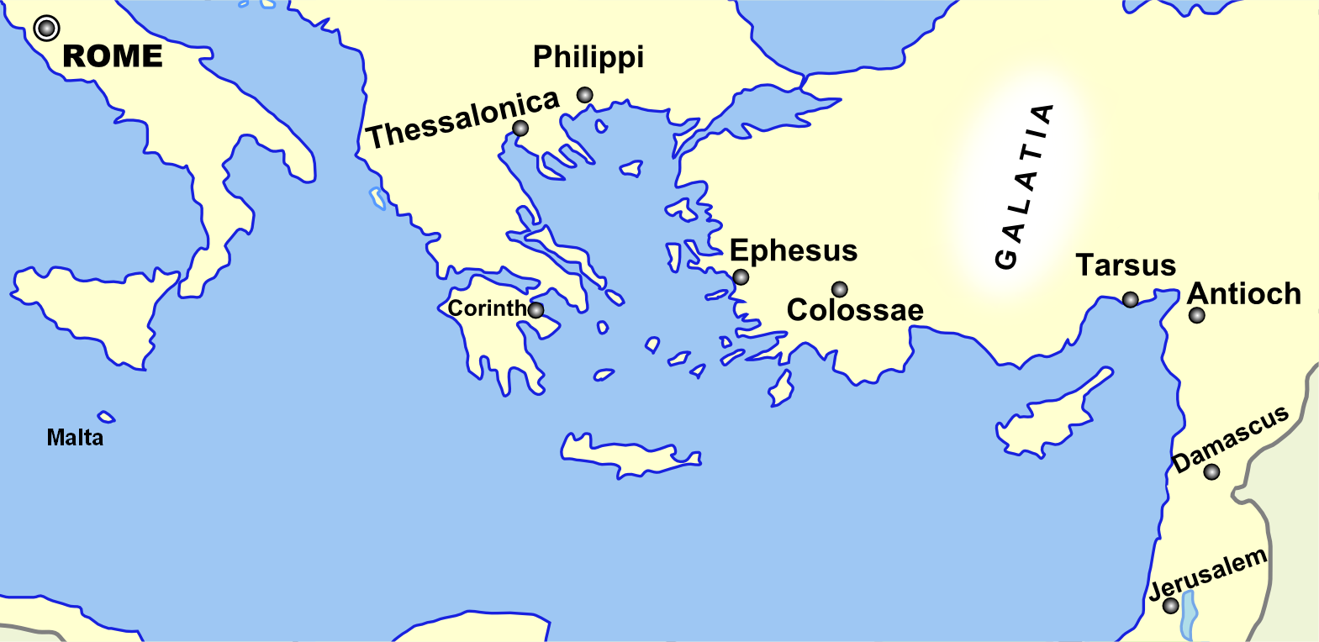
Page 14: Broad Overview of Geography
Monozigote. (2012). Broad Overview of Geography Relevant to Paul of Tarsus [Map]. Wikipedia.

Slide 19
Visitors: loan you a copy for today
Members: get a print edition
Online: visit OurSundaySchool.com

Slide 20
Ephesians, week 1: an introduction
Our resources
The city of Ephesus
Ephesus in the Bible
The letter to the Ephesians
Our series

Slide 21
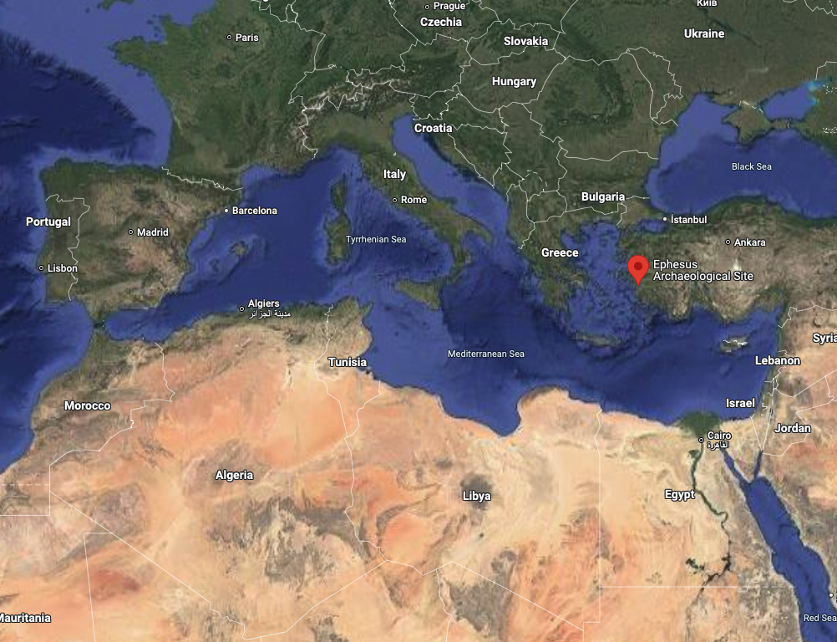
The city of Ephesus

Slide 22
The city of Ephesus (then)
Roman port city (third largest)
Politically important (provincial capital)
Diverse (Artemis, the emperor, and magic)
Architecture, architecture, architecture

Slide 23
The Temple of Artemis

Slide 24
NFL football field: 1.33 acres
360 feet
10
20
30
40
50
40
30
20
10
162 feet
10
20
30
40
50
40
30
20
10

Slide 25
The Temple of Artemis: 2.20 acres
425 feet
225 feet

Slide 26
Dr. Bruce Metzger
It was the largest building known in antiquity

Slide 27
The Temple of Artemis: 2.20 acres
425 feet
10
20
30
40
50
40
30
20
10
225 feet
10
20
30
40
50
40
30
20
10

Slide 28
The Temple of Artemis: 2.20 acres
425 feet
10
20
30
40
50
40
30
20
10
225 feet
10
20
30
40
50
40
30
20
10

Slide 29
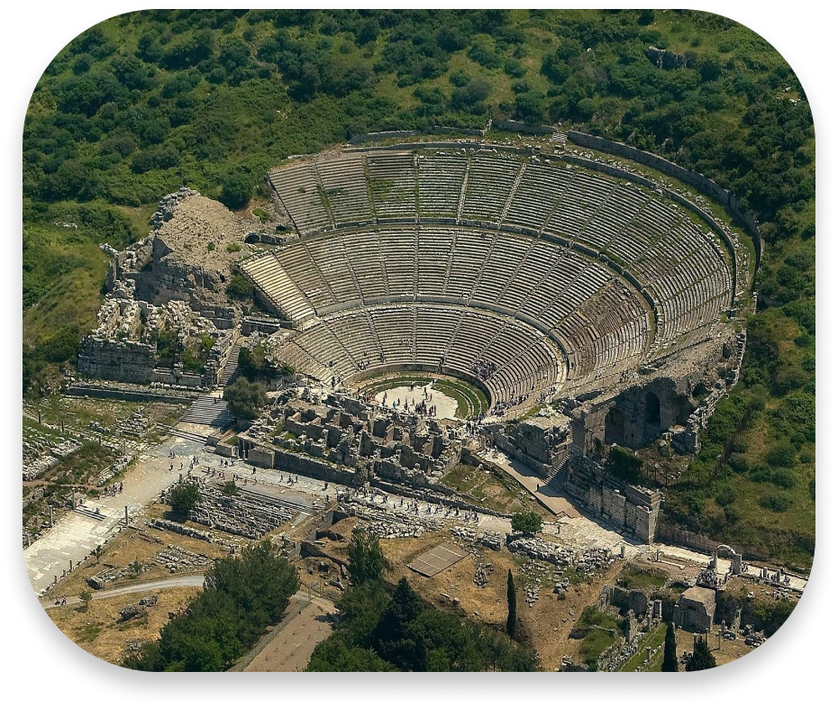
The city of Ephesus: the great theater

Slide 30
Dr. Tony Merida
Ephesus was also home to the Roman emperor cult….

Slide 31
Dr. Tony Merida
Ephesus was also home to the Roman emperor cult…. When Christians said, “Jesus is Lord,” they were saying that Caesar is not.

Slide 32
The city of Ephesus (today)
Silted harbor

Slide 33
The city of Ephesus

Slide 34
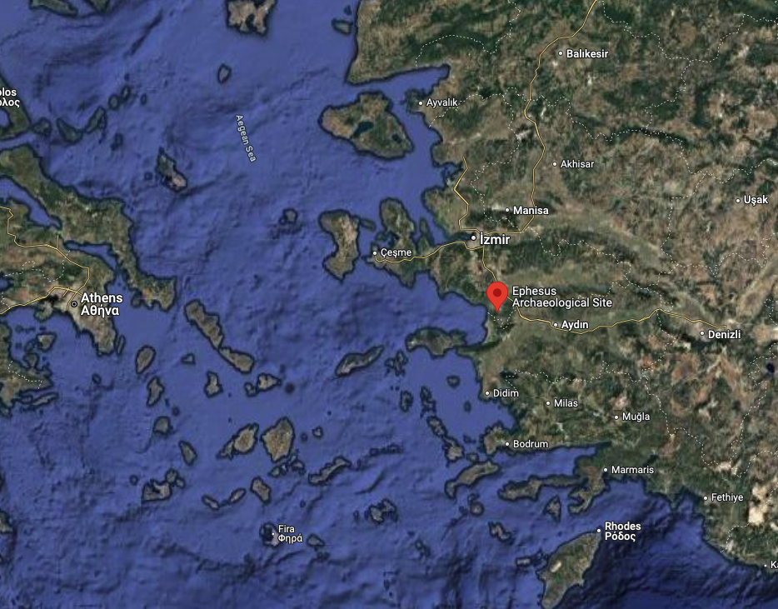
The city of Ephesus

Slide 35
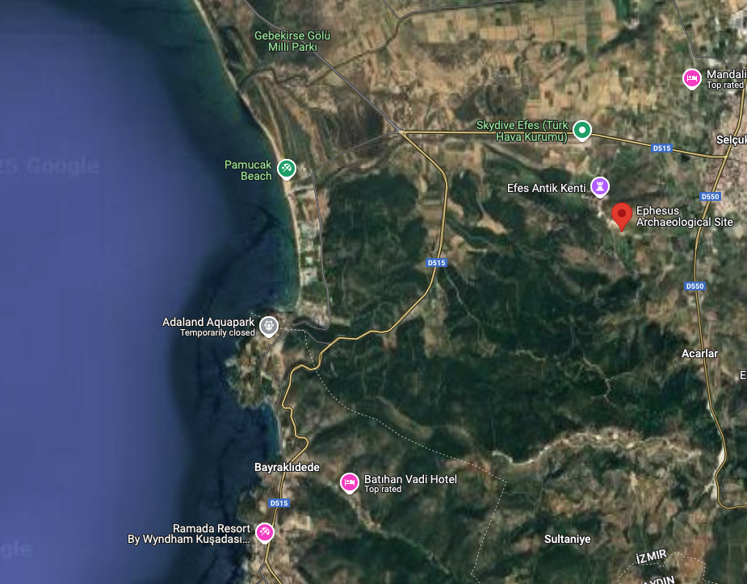
The city of Ephesus (today)

Slide 36
The city of Ephesus (today)
Silted harbor
Ruins (UNESCO World Heritage Site)

Slide 37
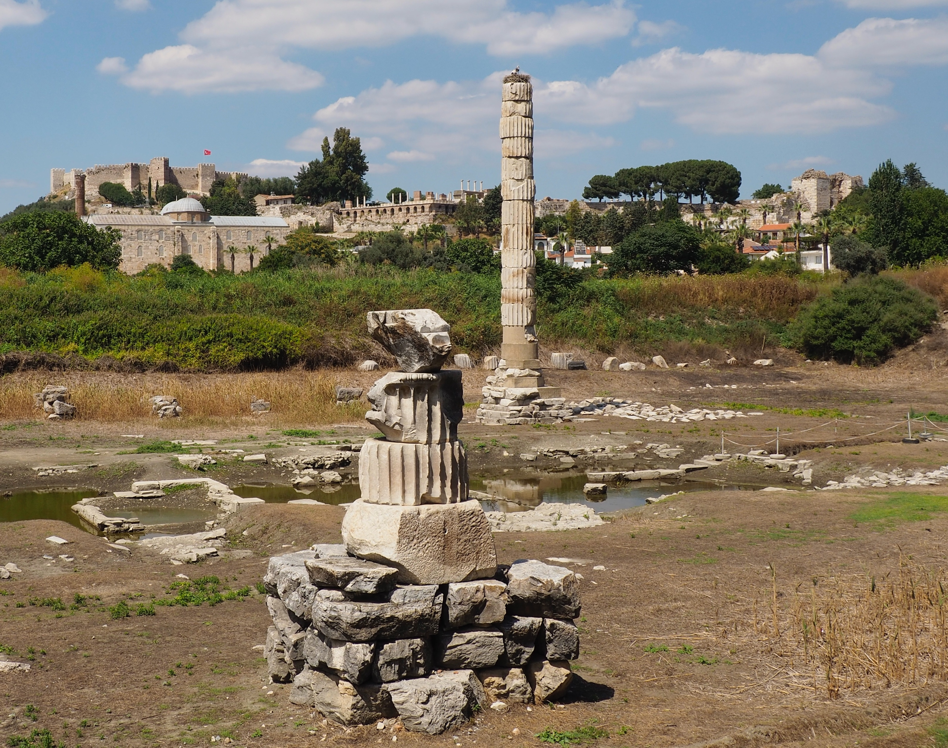
The Temple of Artemis (today)

Slide 38
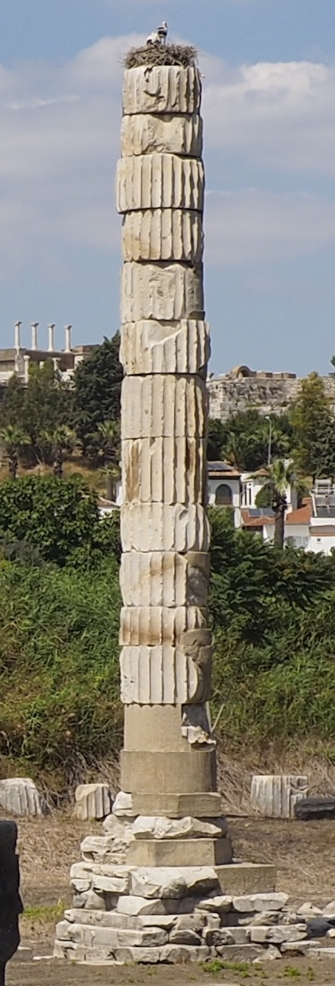
The Temple of Artemis (today)

Slide 39
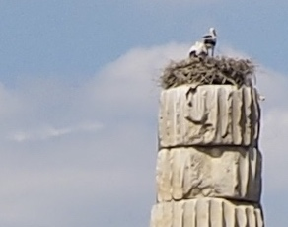
The Temple of Artemis (today)

Slide 40
Ephesians, week 1: an introduction
Our resources
The city of Ephesus
Ephesus in the Bible
The letter to the Ephesians
Our series

Slide 41
Ephesus in the Bible
Acts 18:19–20:38
1 Corinthians 15:32; 16:8-9
Ephesians 1:1
1 Timothy 1:3
2 Timothy 1:18; 4:12
Revelation 1:11; 2:1–7

Slide 42
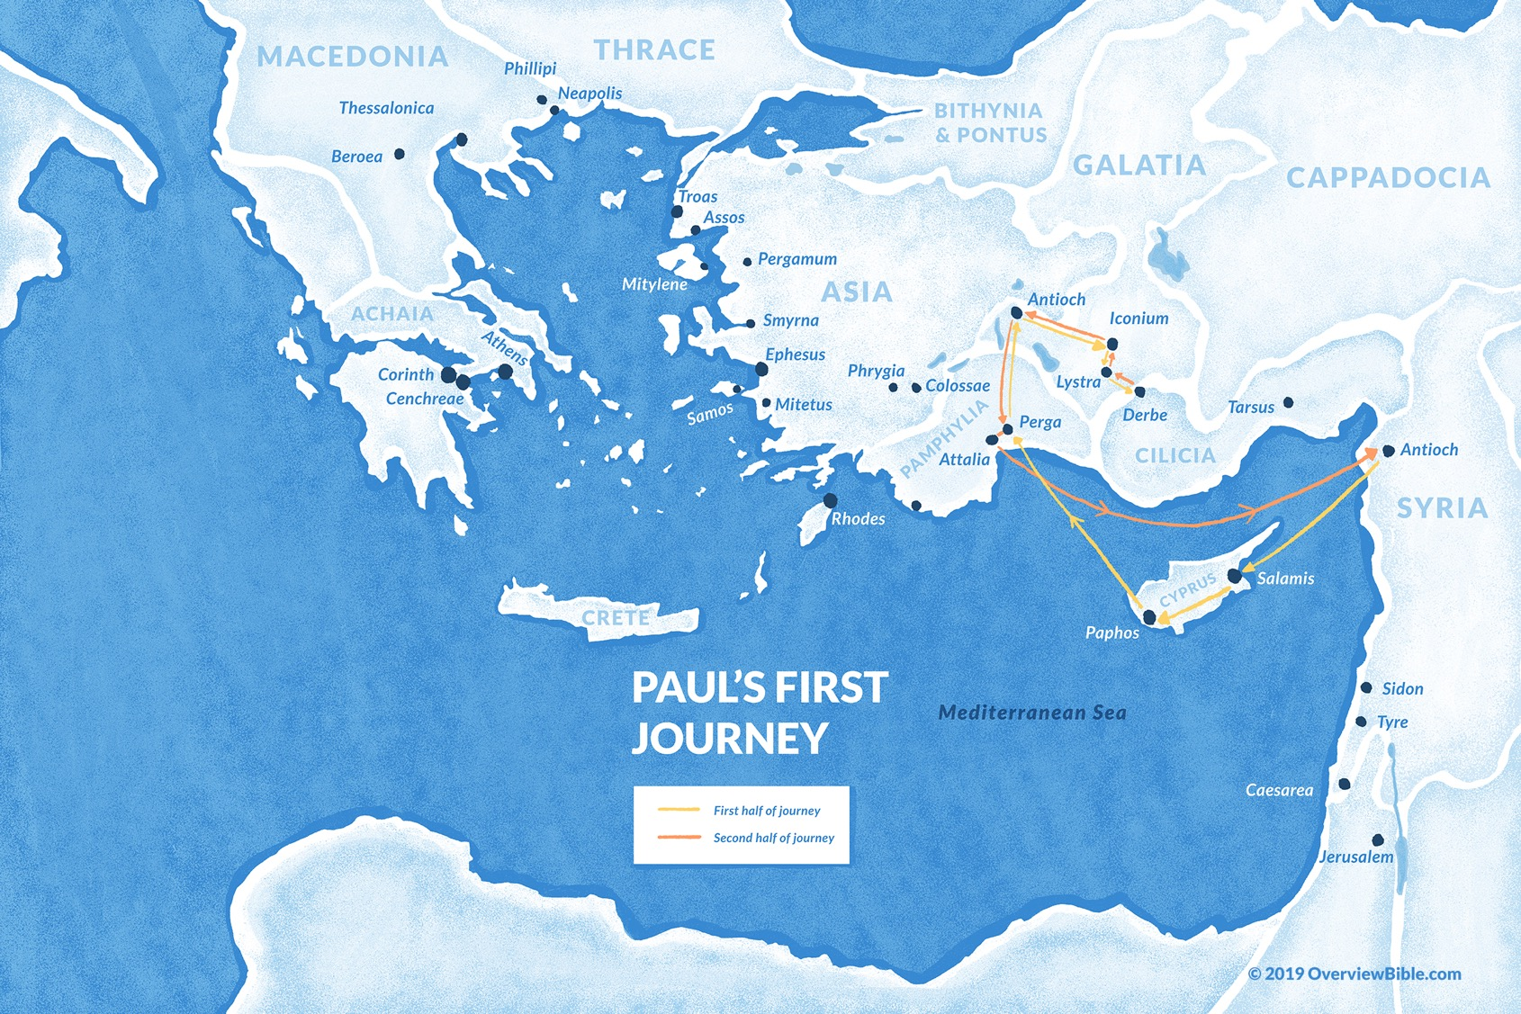
#1
~Acts 13 – 14

Slide 43
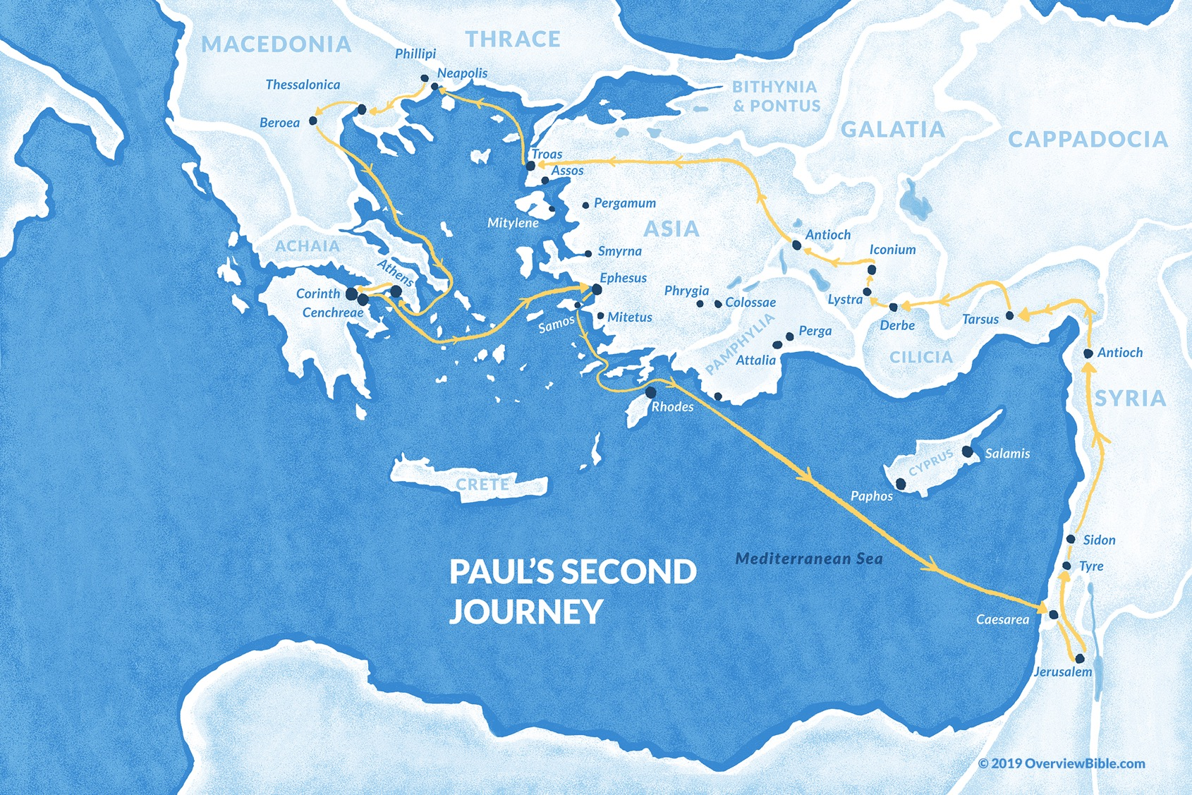
#2
~Acts 15:40 – 18:22

Slide 44
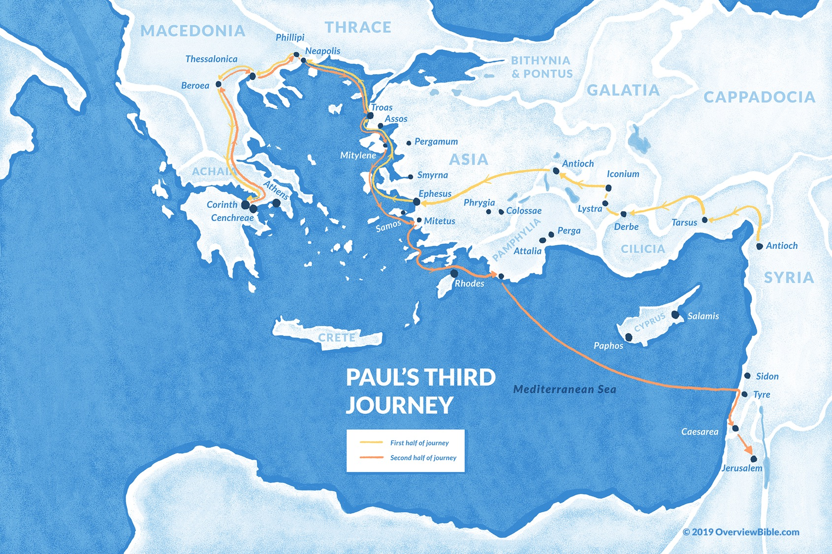
#3
~Acts 18:23 – 21:15

Slide 45
Ephesus in the Bible
Acts 18:19–20:38
1 Corinthians 15:32; 16:8-9
Ephesians 1:1
1 Timothy 1:3
2 Timothy 1:18; 4:12
Revelation 1:11; 2:1–7

Slide 46
The city of Ephesus: the great theater

Slide 47
Ephesus in the Bible
Acts 18:19–20:38
1 Corinthians 15:32; 16:8-9
Ephesians 1:1
1 Timothy 1:3
2 Timothy 1:18; 4:12
Revelation 1:11; 2:1–7

Slide 48
Ephesus in the Bible
Acts 18:19–20:38
1 Corinthians 15:32; 16:8-9
Ephesians 1:1
1 Timothy 1:3
2 Timothy 1:18; 4:12
Revelation 1:11; 2:1–7

Slide 49
Opposition is opportunity
For those opposed to the gospel, the solution is the gospel
For those aligned to the gospel, the solution is the gospel

Slide 50
First
Second
Third
Prison in Caesarea
Prison in Rome
Prison in Rome
46 | 47 | 48 | 49 | 50 | 51 | 52 | 53 | 54 | 55 | 56 | 57 | 58 | 59 | 60 | 61 | 62 | 63 | 64 | 65 | 66 | 67
Ephesus
Romans
2 Timothy
2 Corinthians
1 Timothy Titus
1 Corinthians
2 Thessalonians
Ephesians Philippians Colossians Philemon
1 Thessalonians
Galatians
Dates from the ESV Study Bible

Slide 51
Ephesians, week 1: an introduction
Our resources
The city of Ephesus
Ephesus in the Bible
The letter to the Ephesians
Our series

Slide 52
First
Second
Third
Prison in Caesarea
Prison in Rome
Prison in Rome
46 | 47 | 48 | 49 | 50 | 51 | 52 | 53 | 54 | 55 | 56 | 57 | 58 | 59 | 60 | 61 | 62 | 63 | 64 | 65 | 66 | 67
Ephesus
Romans
2 Timothy
2 Corinthians
1 Timothy Titus
1 Corinthians
2 Thessalonians
Ephesians Philippians Colossians Philemon
1 Thessalonians
Galatians
Dates from the ESV Study Bible

Slide 53
The nouns (and one verb)
Christ (46)
God (31)
Lord (26)
Jesus (20)
Spirit (14)
Grace (12)
Father (11)
Love (10/10)
Human (9)
Wife (9)
Church (9)
Flesh (9)
Body (9)
Glory (8)
Peace (8)
Faith (8)
World (7)
Husband (7)
Desire (7)
Truth (6)
Heart (6)
Mystery (6)
Power (5)
Gentiles (5)
Wealth (5)
Child (5)
Light (5)

Slide 54
The nouns (and one verb) (even)
Christ (46)
God (31)
Lord (26)
Jesus (20)
Spirit (14)
Grace (12)
Father (11)
Love (10/10)
Human (9)
Wife (9)
Church (9)
Flesh (9)
Body (9)
Glory (8)
Peace (8)
Faith (8)
World (7)
Husband (7)
Desire (7)
Truth (6)
Heart (6)
Mystery (6)
Power (5)
Gentiles (5)
Wealth (5)
Child (5)
Light (5)

Slide 55
The nouns (and one verb) (first half)
Christ (46)
God (31)
Lord (26)
Jesus (20)
Spirit (14)
Grace (12)
Father (11)
Love (10/10)
Human (9)
Wife (9)
Church (9)
Flesh (9)
Body (9)
Glory (8)
Peace (8)
Faith (8)
World (7)
Husband (7)
Desire (7)
Truth (6)
Heart (6)
Mystery (6)
Power (5)
Gentiles (5)
Wealth (5)
Child (5)
Light (5)

Slide 56
The nouns (and one verb) (second half)
Christ (46)
God (31)
Lord (26)
Jesus (20)
Spirit (14)
Grace (12)
Father (11)
Love (10/10)
Human (9)
Wife (9)
Church (9)
Flesh (9)
Body (9)
Glory (8)
Peace (8)
Faith (8)
World (7)
Husband (7)
Desire (7)
Truth (6)
Heart (6)
Mystery (6)
Power (5)
Gentiles (5)
Wealth (5)
Child (5)
Light (5)

Slide 57
40 of 41 imperatives are in chapters 4–6

Slide 58
The big picture
Ephesians 1–3: who(se) we are
Ephesians 4–6: what we do as a result

Slide 59
Ways to think about 1–3 / 4–6
Orthodoxy / orthopraxy
Principle / practice
Reality / response
Understand / undertake
Creed / conduct
Doctrine / duty
Foundation / fruit
Learn / live
Instruct / implement

Slide 60
Ways to think about 1–3 / 4–6
Orthodoxy / orthopraxy
Principle / practice
Reality / response
Understand / undertake
Creed / conduct
Doctrine / duty
Foundation / fruit
Learn / live
Instruct / implement

Slide 61
Summary statements
The reality of God and his work requires a response from God’s people
God requires Christian response

Slide 62
Ephesians 1–3

Slide 63
Ephesians, week 1: an introduction
Our resources
The city of Ephesus
Ephesus in the Bible
The letter to the Ephesians
Our series

Slide 64
Our series in Ephesians
Current estimate is ~~November

Slide 65
Our series in Ephesians
Current estimate is ~~November 2026

Slide 66
Dr. Harold Hoehner
John Calvin considered Ephesians as his favorite letter and he preached a series of forty-eight sermons on the book from May 1558 to March 1559

Slide 67
Page 8: Commentaries
Quotes are due to Jim by Thursday night
If you would like one, let Jim know

Slide 68
Next week (dv): Preparing for Ephesians 1 (page 16)
Pray with others Hear with others Think with others Study with others In class, as tables Share with others Invite others After class
In class, as a class

Slide 69
Prayer time
Write down your prayer requests (on the Weekly Update or in the comments)
Lean in, engage, and pray for someone not with you
Be out of this room by 9:50
Go worship

